Slide 1

Introduction to Python Programing language
14th Sep 2018
Dr. Andrew Post
Department of Biomedical Informatics, Emory University, Atlanta, GA USA
Department of Biomedical Engineering, Georgia Institute of Technology, Atlanta, GA, USA

Slide 2

Python
Python is an interpreted high-level programming language for general-purpose programming. Created by Guido van Rossum and first released in 1991
Python 1: 1994
Python 2: 2000
Python 3: 2008
Guido van Rossum
Recent release Python 3.7 - June 27, 2018

Slide 3
Python Features
Dynamic, Strongly typed language
Dynamic Typing | Static Typing
A variable can be bound to an object of any type, which is inferred at runtime. | A variable is bound to a type and an object (optional).
Ex. X = 20 | int X = 20
Once declared, an object of any type can be assigned at runtime | Assignment of any other type of object to the variable will raise an exception
Ex. X = “Hello!” (OK) | X = “Hello!” (Error)
Strong Typing | Weak Typing
A variable cannot be coerced into unrelated types, like String to int | Variables can be implicitly coerced into unrelated types
A = 10 B = “20” Add(A,B) (Error) | A = 10 B = “20” Add(A,B) (OK. Result: 30)

Slide 4
Python Features
Python is interpreted – enabling rapid development
Code written in Python is compact compared to C/C++/Java
Provides efficient high level data structures
Minimalistic syntax
Free extensive standard library available for all major platforms
Free third party Python modules, programs and tools available

Slide 5
Python Applications
Web Development
Games
Graphics
Financial
Science
Electronic Design Automation
Software Development
Education
Business Software
Government
https://wiki.python.org/moin/OrganizationsUsingPython

Slide 6
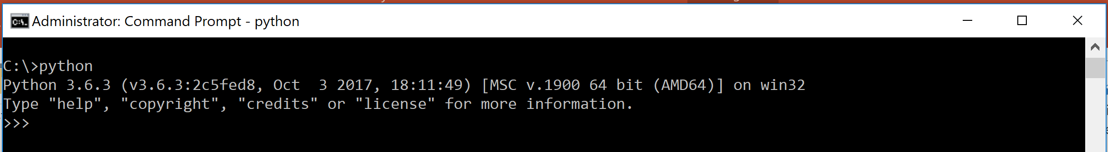
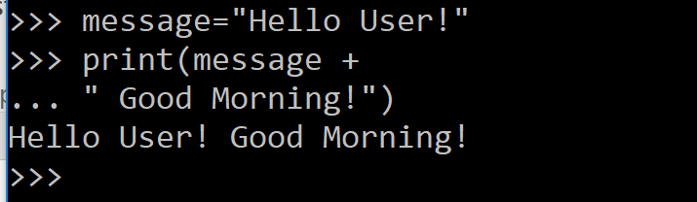
Interpreter Basics
Interpreter can be launched from the command line by typing: python
The interpreter waits for a command to be typed with the primary prompt (>>>) in the interactive mode
When a statement is incomplete, the interpreter waits for completion with a secondary prompt (…)
Output lines ( * ) are recognized by the absence of the prompts (>>> OR …)
*

Slide 7
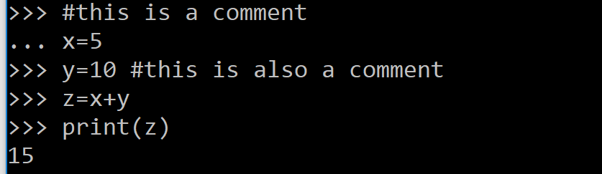
Language Basics
Comments begin with # (hash), and include all the text till the end of the line
No end of statement semicolons are required.
No braces are required to enclose blocks. Statements are grouped by indentation and when indented inappropriately, an error is thrown:
IndentationError: unexpected indent

Slide 8
Numbers
Number addition, subtraction and multiplication similar to other languages: +/-/*
Division operator always returns a float value: / (7/5 = 1.4)
To discard the fractional part and get an int result, use // (7//5 = 1)
Remainder: % (7%5 = 2)
Calculate powers using ** (2**3 = 8)
When mixed type operands are used, int is converted to float
Python also supports complex numbers (imaginary part denoted by suffix j or J: 5+7j)

Slide 9
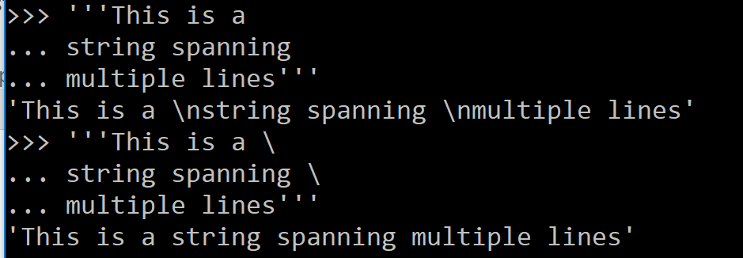
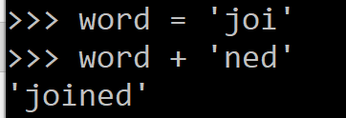
Strings
Strings are enclosed in single or double quotes. \ is used to escape quotes (‘hasn\’t’)
Strings can span multiple lines when enclosed in triple quotes. New line characters \n can be eliminated by ending each line with a \
Adjacent String literals are concatenated: ‘con’ ‘catenated’ = ‘concatenated’
Variables can be concatenated using + operator
Strings can be repeated using * operator: 4*’run’ = ‘runrunrunrun’

Slide 10
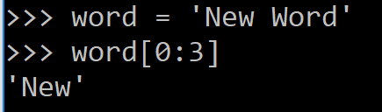
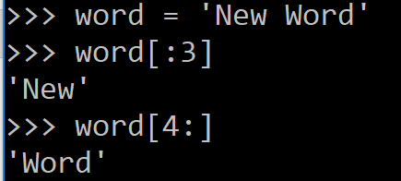
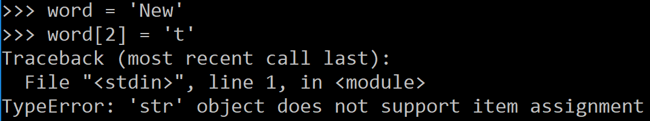
More Strings
A character is just a string of size 1
Strings are indexed, with the first character being at position 0 (from the left)
Negative indices start with -1, from the right: ‘string’ - g is at position -1
Slicing allows creation of substrings:
characters from position 0 to 3 (excluded)
Omitted first index defaults to 0
Omitted last index defaults to length of the string
An index larger than the size of the string results in an error
Strings are immutable

Slide 11
String Functions
All common operations are implemented as functions:
- len(), format(), capitalize(), isalnum() etc.
Complete listing of methods:
https://docs.python.org/3/library/stdtypes.html#string-methods

Slide 12
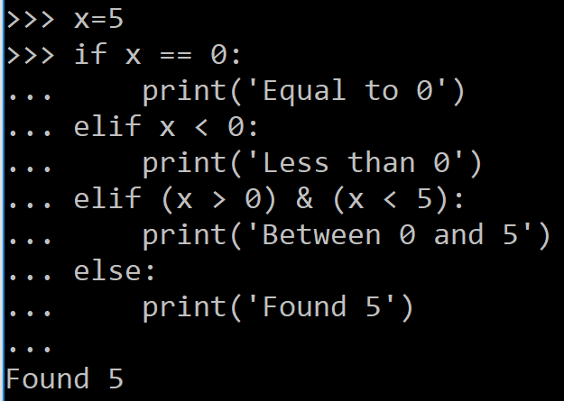
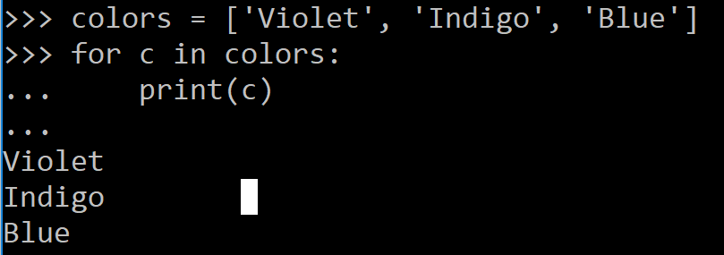
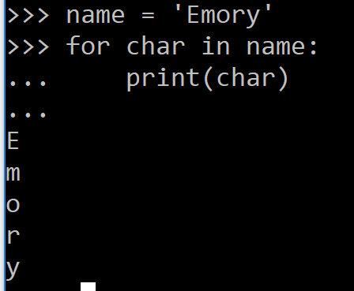
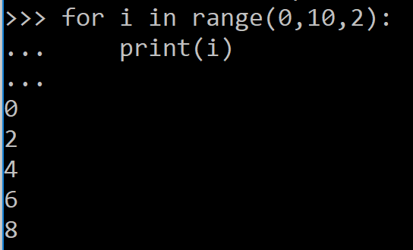
Control Flow
The if statement: 1. There can be 0 or more ‘elif’
2. ‘else’ is optional
The for statement:
The for statement:
Can iterate over members of a list or string
Range function in conjunction with for, can iterate over a sequence of numbers with user specified increments

Slide 13
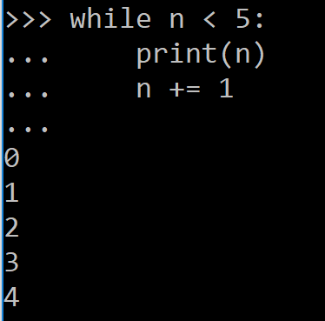
Control Flow
The while statement:
The break and continue statements:
‘break’ statement breaks out of the enclosing for/while loop
‘continue’ statement continues with the next iteration of the loop
The else statement: Loops in Python have an else statement which is evaluated after the loop iteration completes or when loop condition becomes false
The pass statement: Does nothing. Used in cases where a statement is required syntactically but no action is required

Slide 14
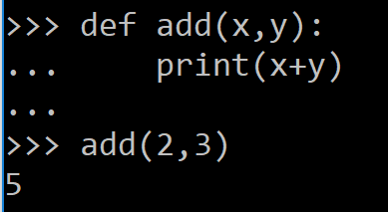
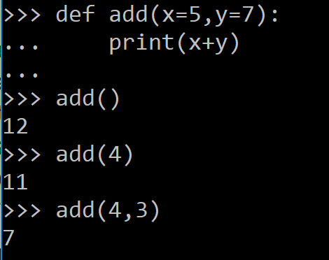
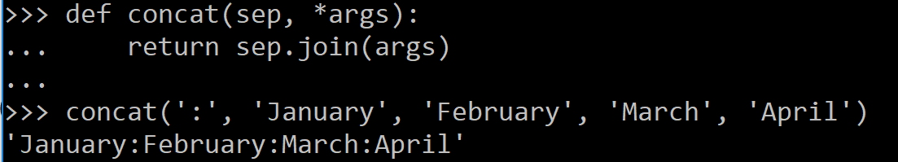
Functions
Functions are defined using keyword def:
Functions without a return statement are valid – they return a value ‘None’ which is suppressed by the interpreter
Arguments can be given default values:
- this allows the functions to be
called in several ways
Variadic arguments: functions can be defined to accept arbitrary number of arguments using *args notation:
These should be last in the list of parameters

Slide 15
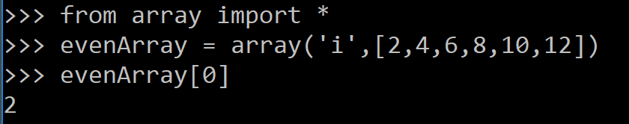
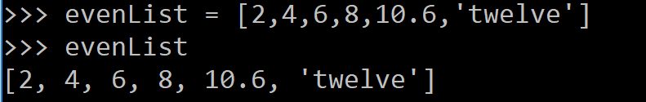
Data Structures - Lists and Arrays
 | Arrays | Lists
Declaration | ‘i’ in the declaration refers to element type – int in this case | Element of any type can be stored in the list
Indexing | Starts at 0 and elements can be accessed using the index: evenArray[1] = 4 OR evenList[1] = 4 Negative indices access elements from the right: evenArray[-1] = 12 OR evenList[-1] = ‘twelve’
Methods | insert(index, value), append(value) etc. Complete list: https://docs.python.org/3/library/array.html | insert(index,value), append(value) etc. Complete list: https://docs.python.org/3/tutorial/datastructures.html
Uses | Useful to store large amounts of homogeneous data | Useful to store heterogeneous data and in instances where the list needs to grow and shrink freely

Slide 16
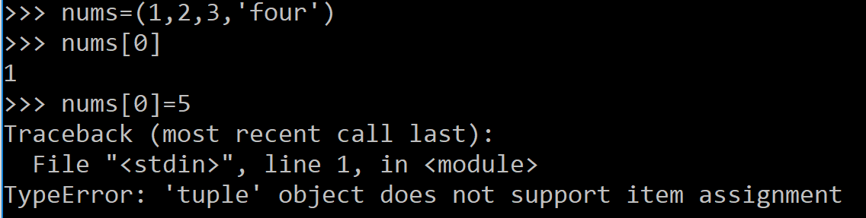
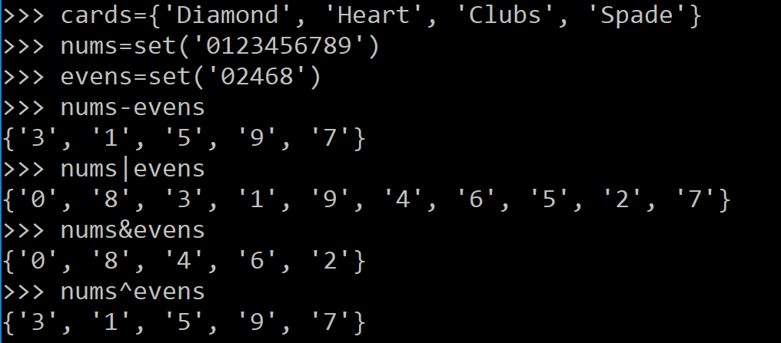
Data Structures – Tuples and Sets
Tuple: is a comma separated list of homogeneous/heterogeneous values enclosed in parentheses
Unlike Lists, Tuples are immutable:
Tuple with 0 items: nums=()
Tuple with 1 item: nums(1,) – the comma is required
Sets are unordered collections with no duplicate entries:
Declaration method 1:
Declaration method 2 using ‘set’ keyword
All set operations can be performed

Slide 17
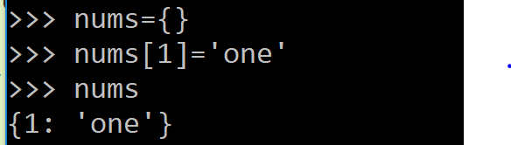

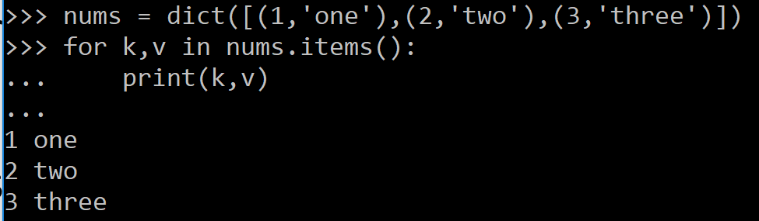
Data Structures - Dictionaries
Similar to Associative arrays, these are sets of key:value pairs
Keys have to be unique
Declaration: OR
Can list keys using the list() method or sorted() method
Keys must be of immutable type. Numbers and strings can be used as keys
Can retrieve both keys and values using the items() method

Slide 18
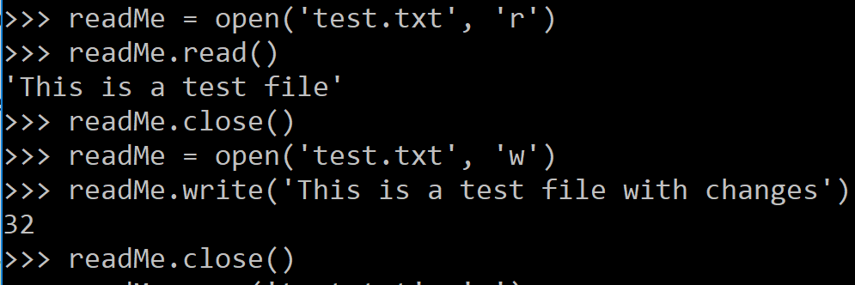
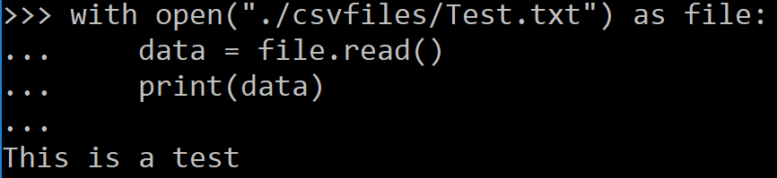
Input and Output
The print() function prints to standard out
To read from a file, use the open() function:
File can be opened in ‘r’ for read, ‘w’
for write or ‘a’ for append modes
The File must be closed after the
read/write operation using close() function
Using the with statement is a cleaner way to do File IO in Python. Close() is called automatically:

Slide 19
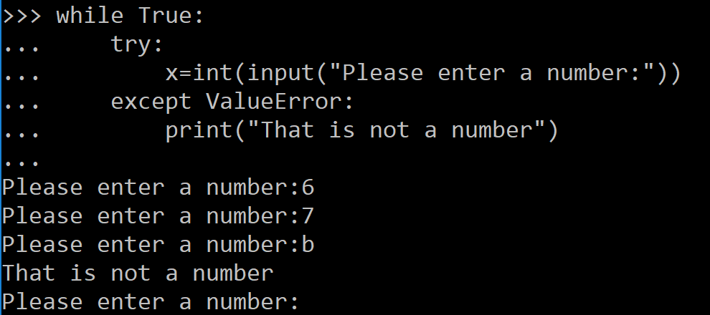
Errors and Exceptions
Python has 2 types of errors: Syntax errors and Exceptions
Syntax errors are also called parsing errors
Errors that occur during execution are called Exceptions – can be handled using ‘try-except’ statements:
A try statement can have more than one except clause, but only one handler will be executed

Slide 20
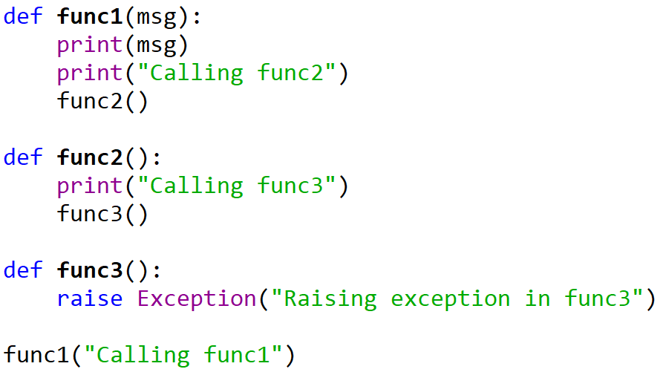
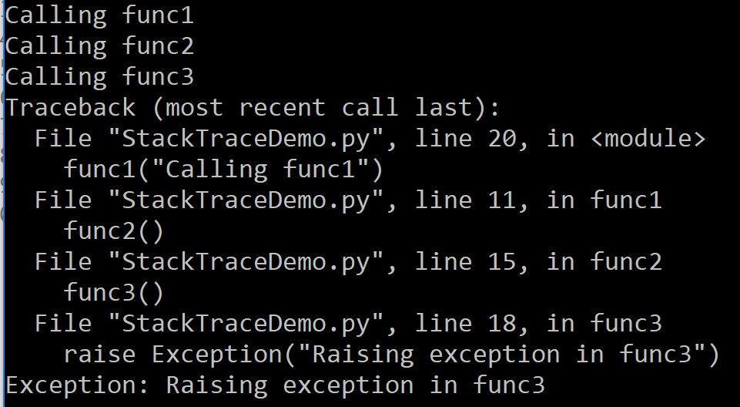
Errors and Exceptions – The Stack Trace
Python has 2 types of errors: Syntax errors and Exceptions

Slide 21
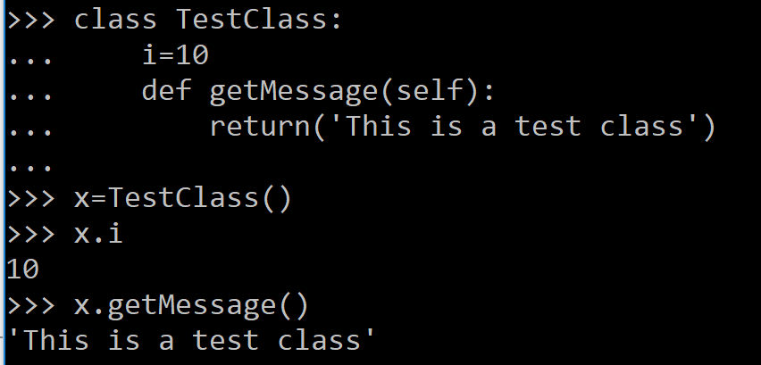
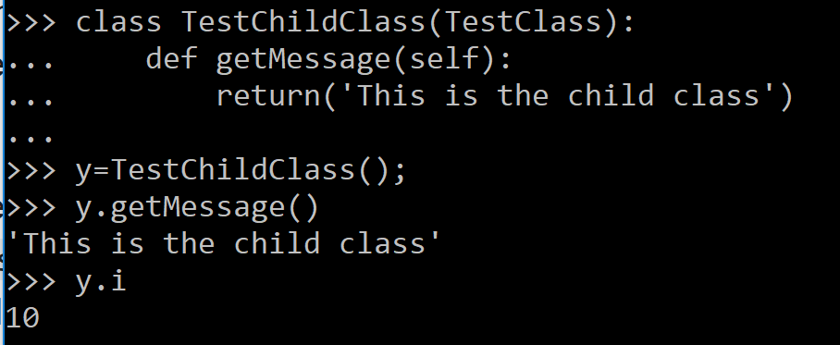
Classes
Python classes support all standard features of Object Oriented Programming:
Class instantiation uses function notation
Object attributes and methods can be referenced
Derived classes can be created from the base class
Attributes missing in the derived class are looked
up in the base class (ex., ‘i’ comes from the base
class)
Methods in the derived class override the base class
methods
Python supports Multiple Inheritance

Slide 22
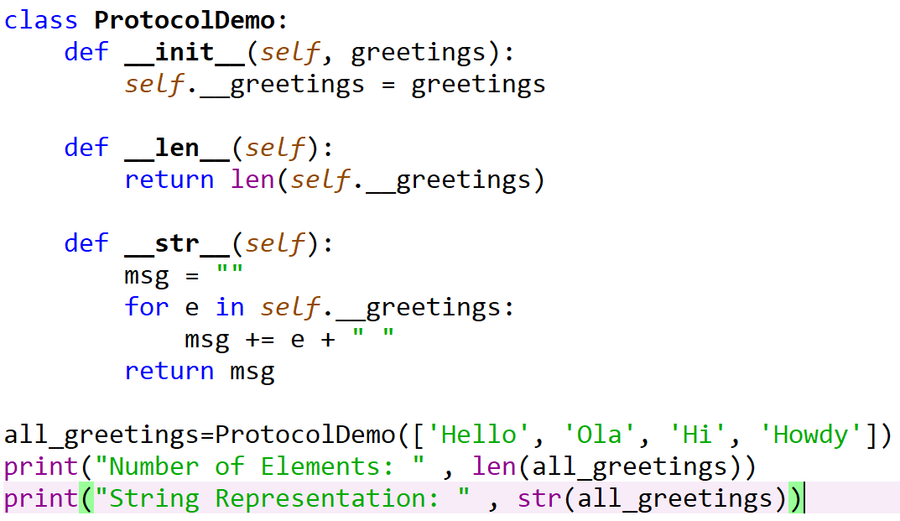
Protocols
Python does not have the interface keyword
Classes can add specific behavior by implementing informal interfaces: Protocols
Ex:
The iterable protocol is implemented by adding the method __iter__ to a class and providing an implementation for it.
The sized protocol is implemented by adding the method __len__ to a class and providing an implementation for it.
The str protocol is implemented by adding the method __str__ to a class and providing an implementation for it.

Slide 23
Modules, Packages
Long programs can be split into several files called ‘modules’ and imported
Modules can contain executable statements and functions
Modules can import other modules. The import statements are placed at the top of each module by convention
Modules can be placed into packages thereby creating a dotted namespace for the modules – developers of modules don’t have to worry about duplicate module names, as long as they are in different packages
Entire package or individual modules or single functions from a module can be imported

Slide 24
Examples for modules
The Python code for a module named mymodule normally resides in a file named mymodule.py. Here's an example of a simple module, support.py
def print_func( par ):
print ("Hello : ", par)
return
Import Statement:
You can use any Python source file as a module by executing an import statement in some other Python source file. The import has the following syntax −
import module1[, module2[,... moduleN]

Slide 25
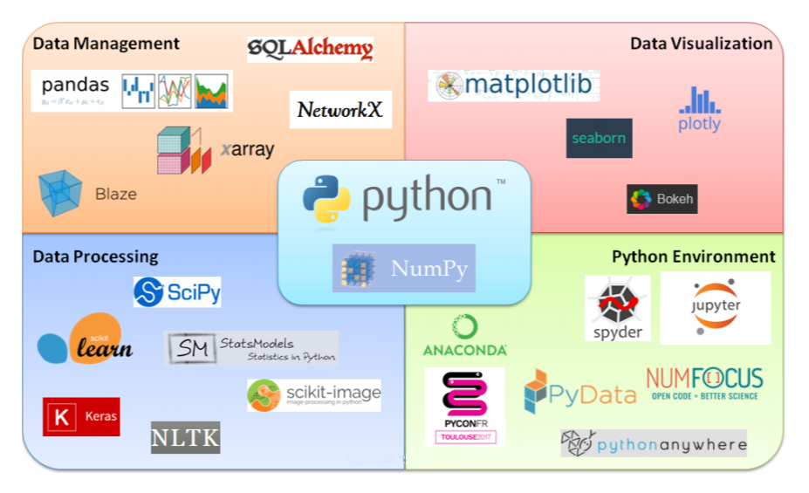
Python Packages

Slide 26
Regular Expressions
A regular expression is a special sequence of characters that helps you match or find other strings or sets of strings, using a specialized syntax held in a pattern
The module re provides full support for Perl-like regular expressions in Python
The match Function
This function attempts to match regular expression pattern to string with optional flags.
Here is the syntax for this function −
re.match(pattern, string, flags=0)
flags
You can specify different flags using bitwise OR (|).
The re.match function returns a match object on success, None on failure. We usegroup(num) or groups() function of match object to get matched expression.
import re
result = re.match(r'Emory', 'Emory Python Lab')
print (result.group(0))

Slide 27
Regular Expressions
the 'r' means the the following is a "raw string", ie. backslash characters are treated literally instead of signifying special treatment of the following character.
so '\n' is a single newline
and r'\n' is two characters - a backslash and the letter 'n'
another way to write it would be '\\n' because the first backslash escapes the second
an equivalent way of writing this
print (re.sub(r'(\b\w+)(\s+\1\b)+', r'\1', 'hello there there'))
is
print (re.sub('(\\b\\w+)(\\s+\\1\\b)+', '\\1', 'hello there there'))

Slide 28
Regular Expressions
The ‘re’ package provides multiple methods to perform queries on an input string. Here are the most commonly used methods,
re.match(): If zero or more characters at the beginning of string match the regular expression pattern, return a corresponding match object.
re.search(): Scan through string looking for the first location where the regular expression pattern produces a match, and return a corresponding match object
re.findall(): Return all non-overlapping matches of pattern in string, as a list of strings. The string is scanned left-to-right, and matches are returned in the order found
re.split(): Split string by the occurrences of pattern. If capturing parentheses are used in pattern, then the text of all groups in the pattern are also returned as part of the resulting list
re.sub(): Return the string obtained by replacing the leftmost non-overlapping occurrences of pattern in string by the replacement repl. If the pattern isn’t found, string is returned unchanged
re.compile(): Compile a regular expression pattern into a regular expression object, which can be used for matching using its match(), search() and other methods

Slide 29
Regular Expression Patterns
^ Matches beginning of line.
$ Matches end of line.
. Matches any single character except newline. Using m option allows it to match newline as well.
[...] Matches any single character in brackets.
[^...] Matches any single character not in brackets
re* Matches 0 or more occurrences of preceding expression.
re+ Matches 1 or more occurrence of preceding expression.
re? Matches 0 or 1 occurrence of preceding expression.
re{ n} Matches exactly n number of occurrences of preceding expression.

Slide 30
Regular Expression Patterns
re{ n,} Matches n or more occurrences of preceding expression.
re{ n, m} Matches at least n and at most m occurrences of preceding expression.
a| b Matches either a or b.
(re) Groups regular expressions and remembers matched text.
(?imx) Temporarily toggles on i, m, or x options within a regular expression. If in parentheses, only that area is affected.
(?-imx) Temporarily toggles off i, m, or x options within a regular expression. If in parentheses, only that area is affected.
(?: re) Groups regular expressions without remembering matched text.
(?imx: re) Temporarily toggles on i, m, or x options within parentheses.
(?-imx: re) Temporarily toggles off i, m, or x options within parentheses.
(?#...) Comment.

Slide 31
Regular Expression Patterns
(?= re) Specifies position using a pattern. Doesn't have a range.
(?! re) Specifies position using pattern negation. Doesn't have a range.
(?> re) Matches independent pattern without backtracking.
\w Matches word characters.
\W Matches nonword characters.
\s Matches whitespace. Equivalent to [\t\n\r\f].
\S Matches nonwhitespace.
\d Matches digits. Equivalent to [0-9].

Slide 32
Regular Expression Patterns
\D Matches nondigits.
\A Matches beginning of string.
\Z Matches end of string. If a newline exists, it matches just before newline.
\z Matches end of string.
\G Matches point where last match finished.
\b Matches word boundaries when outside brackets. Matches backspace (0x08) when inside brackets.
\B Matches nonword boundaries.
\n, \t, etc. Matches newlines, carriage returns, tabs, etc.
\1...\9 Matches nth grouped subexpression.
\10 Matches nth grouped subexpression if it matched already. Otherwise refers to the octal representation of a character code.

Slide 33
Regular Expressions Modifiers: Option Flags
Regular expression literals may include an optional modifier to control various aspects of matching. The modifiers are specified as an optional flag. You can provide multiple modifiers using exclusive OR (|), as shown previously and may be represented by one of these −
These are few modifiers, which are listed in the table below.
re.I : Performs case-insensitive matching.
re.L : Interprets words according to the current locale. This interpretation affects the alphabetic group (\w and \W), as well as word boundary behavior(\b and \B).
re.M : Makes $ match the end of a line (not just the end of the string) and makes ^ match the start of any line (not just the start of the string).
re.S : Makes a period (dot) match any character, including a newline.
re.U : Interprets letters according to the Unicode character set. This flag affects the behavior of \w, \W, \b, \B.
re.X : Permits "cuter" regular expression syntax. It ignores whitespace (except inside a set [] or when escaped by a backslash) and treats unescaped # as a comment marker.

Slide 34
Multi threading
Running several threads is similar to running several different programs concurrently, but with the following benefits −
Multiple threads within a process share the same data space with the main thread and can therefore share information or communicate with each other more easily than if they were separate processes.
Threads sometimes called light-weight processes and they do not require much memory overhead; they are cheaper than processes.
Example : starting new thread
thread.start_new_thread ( function, args[, kwargs] )
A Minimal Example with Object
#!/usr/bin/env python
import threading
import time
class MyThread(threading.Thread):
def run(self):
print("{} started!".format(self.getName())) # "Thread-x started!"
time.sleep(1) # Pretend to work for a second
print("{} finished!".format(self.getName())) # "Thread-x finished!"
if __name__ == '__main__':
for x in range(4): # Four times...
mythread = MyThread(name = "Thread-{}".format(x + 1)) # ...Instantiate a thread and pass a unique ID to it
mythread.start() # ...Start the thread
time.sleep(.9) # ...Wait 0.9 seconds before starting another

Slide 35
Global Interpreter Lock (GIL)
Python uses reference counting for memory management. It means that objects created in Python have a reference count variable that keeps track of the number of references that point to the object. When this count reaches zero, the memory occupied by the object is released.
this reference count variable needed protection from race conditions where two threads increase or decrease its value simultaneously. If this happens, it can cause either leaked memory that is never released or, even worse, incorrectly release the memory while a reference to that object still exists. This can can cause crashes or other “weird” bugs in your Python programs

Slide 36
Global Interpreter Lock (GIL)
This reference count variable can be kept safe by adding locks to all data structures that are shared across threads so that they are not modified inconsistently. But adding a lock to each object or groups of objects means multiple locks will exist which can cause another problem—Deadlocks
The GIL is a single lock on the interpreter itself which adds a rule that execution of any Python bytecode requires acquiring the interpreter lock. This prevents deadlocks (as there is only one lock) and doesn’t introduce much performance overhead. But it effectively makes any CPU-bound Python program single-threaded

Slide 37
Standard Libraries
Operating System Interface
The os module provides dozens of functions for interacting with the operating system
File Wildcards
The glob module provides a function for making file lists from directory wildcard searches
Error Output Redirection and Program Termination
The sys module also has attributes for stdin, stdout, and stderr. The latter is useful for emitting warnings and error messages to make them visible even when stdout has been redirected
String Pattern Matching
The re module provides regular expression tools for advanced string processing. For complex matching and manipulation, regular expressions offer succinct, optimized solutions

Slide 38
Standard Libraries
Mathematics
The math module gives access to the underlying C library functions for floating point math
The random module provides tools for making random selections
The statistics module calculates basic statistical properties (the mean, median, variance, etc.) of numeric data
Internet Access
There are a number of modules for accessing the internet and processing internet protocols. Two of the simplest are urllib.request for retrieving data from URLs and smtplib for sending mail
Dates and Times
The datetime module supplies classes for manipulating dates and times in both simple and complex ways. While date and time arithmetic is supported, the focus of the implementation is on efficient member extraction for output formatting and manipulation. The module also supports objects that are timezone aware
Data Compression
Common data archiving and compression formats are directly supported by modules including: zlib, gzip, bz2, lzma, zipfile and tarfile.

Slide 39
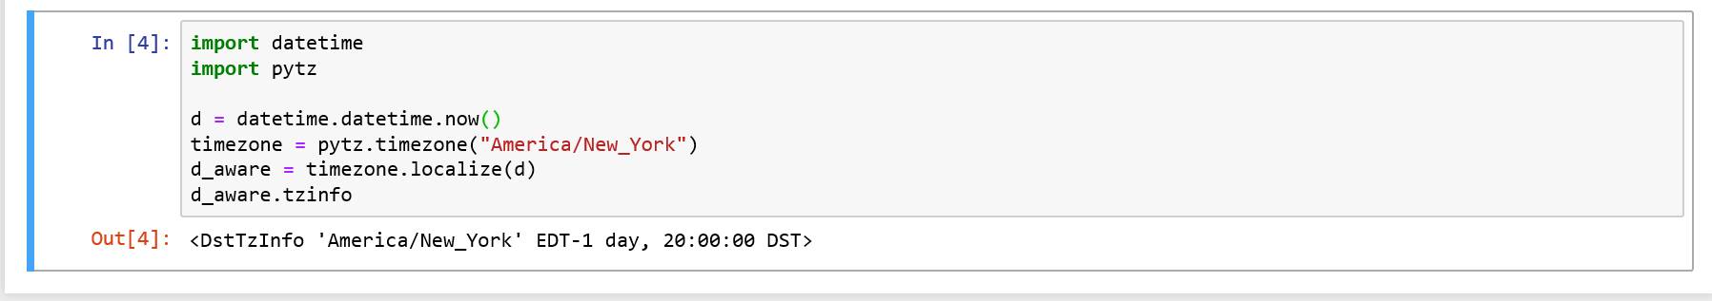
Standard Libraries
Dates and Times : To make a datetime object offset aware, you can use the pytz library. First, you have to instantiate a timezone object, and then use that timezone object to "localize" a datetime object. Localizing simply gives the object timezone information

Slide 40
Standard Libraries
Quality Control
The doctest module provides a tool for scanning a module and validating tests embedded in a program’s docstrings. Test construction is as simple as cutting-and-pasting a typical call along with its results into the docstring. This improves the documentation by providing the user with an example and it allows the doctest module to make sure the code remains true to the documentation
Output Formatting
The reprlib module provides a version of repr() customized for abbreviated displays of large or deeply nested containers
The pprint module offers more sophisticated control over printing both built-in and user defined objects in a way that is readable by the interpreter. When the result is longer than one line, the “pretty printer” adds line breaks and indentation to more clearly reveal data structure
The textwrap module formats paragraphs of text to fit a given screen width
The locale module accesses a database of culture specific data formats. The grouping attribute of locale’s format function provides a direct way of formatting numbers with group separators
Working with Binary Data Record Layouts
The struct module provides pack() and unpack() functions for working with variable length binary record formats

Slide 41
Standard Libraries
Logging
The logging module offers a full featured and flexible logging system. At its simplest, log messages are sent to a file or to sys.stderr
Tools for Working with Lists
Many data structure needs can be met with the built-in list type. However, sometimes there is a need for alternative implementations with different performance trade-offs
The array module provides an array() object that is like a list that stores only homogeneous data and stores it more compactly
The collections module provides a deque() object that is like a list with faster appends and pops from the left side but slower lookups in the middle. These objects are well suited for implementing queues and breadth first tree searches
The heapq module provides functions for implementing heaps based on regular lists. The lowest valued entry is always kept at position zero. This is useful for applications which repeatedly access the smallest element but do not want to run a full list sort

Slide 42
Installation
Python can be obtained from the Python Software Foundation website at python.org. Typically, that involves downloading the appropriate installer for your operating system and running it on your machine.
Some operating systems, notably Linux, provide a package manager that can be run to install Python.
On macOS, the best way to install Python 3 involves installing a package manager called Homebrew.
On mobile operating systems like Android and iOS, you can install apps that provide a Python programming environment. This can be a great way to practice your coding skills on the go (I recommend Pythonista 3 for iOS , Pydroid 3 for Android)
For todays lab work we are going to install Python with Anaconda.

Slide 43
Installing Anaconda
System requirements
32- or 64-bit computer.
For Anaconda—Minimum 3 GB disk space to download and install.
Windows, macOS or Linux.
NOTE: You do not need administrative or root permissions to install Anaconda if you select a user-writable install location.

Slide 44
Installing Anaconda
On Windows
Download the installer:
Anaconda installer for Windows. (https://www.anaconda.com/download/)
Double-click the .exe file.
Follow the instructions on the screen.
If you are unsure about any setting, accept the defaults. You can change them later.
When installation is finished, from the Start menu, open the Anaconda Prompt.

Slide 45
Installing Anaconda
On macOS
Download the installer:
Anaconda installer for macOS. (https://www.anaconda.com/download/#macos)
Install:
Anaconda—Double-click the .pkg file.
Follow the prompts on the installer screens.
If you are unsure about any setting, accept the defaults. You can change them later.
To make the changes take effect, close and then re-open your Terminal window.

Slide 46
Installing Anaconda
On Linux
Download the installer:
Anaconda installer for Linux. (https://www.anaconda.com/download/#linux)
In your Terminal window, run:
bash Anaconda-latest-Linux-x86_64.sh
Follow the prompts on the installer screens.
If you are unsure about any setting, accept the defaults. You can change them later.
To make the changes take effect, close and then re-open your Terminal window.

Slide 47
Testing your installation
To test your installation, in your Terminal window or Anaconda Prompt, run the command
conda list
For a successful installation, a list of installed packages appears.
Reference for Anaconda installation : https://conda.io/docs/user-guide/install/index.html

Slide 48
Installing Python Packages - pip
Confirm that pip is installed by typing pip --version on the command line
If pip is installed, skip to step 4
2. If pip is not installed, download it from: https://bootstrap.pypa.io/get-pip.py
3. Run python get-pip.py on the command line
4. Use pip to install latest version of any Python package (substitute PackageName with the name of the package to be installed. Ex: pandas): pip install PackageName

